Slide 1
Essay 2 Beginning

Slide 3
Essay 2 Beginning
Introduce the Fundamental Structure to your essay
Set up the intellectual moves that you’ll be making
Provide a roadmap of the structure of your essay
Offer a brief evaluation of an Established View
Merit(s) of the argument in the EV
Flaw(s) of the argument in the EV
Suggest a correction to the flaw(s) – a new interpretation that will become your thesis

Slide 4
Essay 2 Beginning
Begin with a transition sentence that introduces a problem or leads to series of questions
Introduce the Established View (author’s name, title, genre)
How does the EV answer the Qs?
Briefly describe the merit(s) of the EV.
Introduce a flaw in the EV – (“But,” “However,” “Yet”)
Offer a correction to the EV that will become your thesis
Suggest why the problem is important to consider and how your thesis points toward this broader consideration (motive)

Slide 5
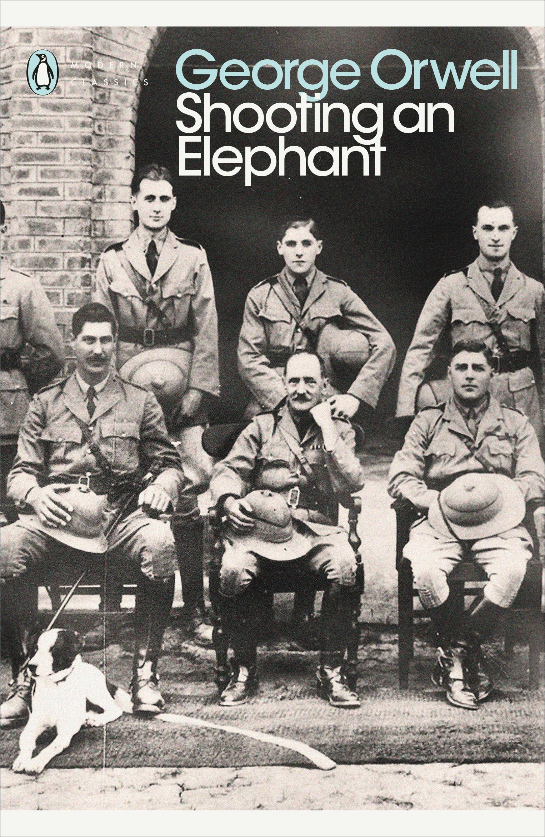
George Orwell
Shooting an Elephant (c. 1936)

Slide 6
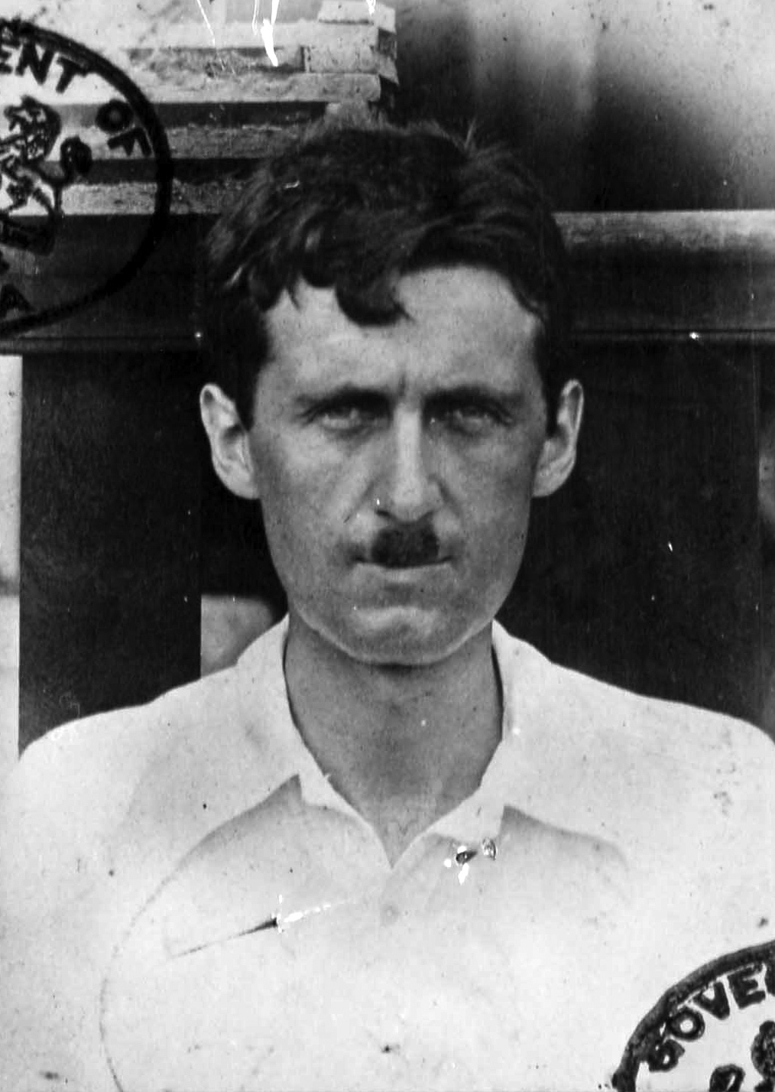
George Orwell
Shooting an Elephant (c. 1936)

Slide 8
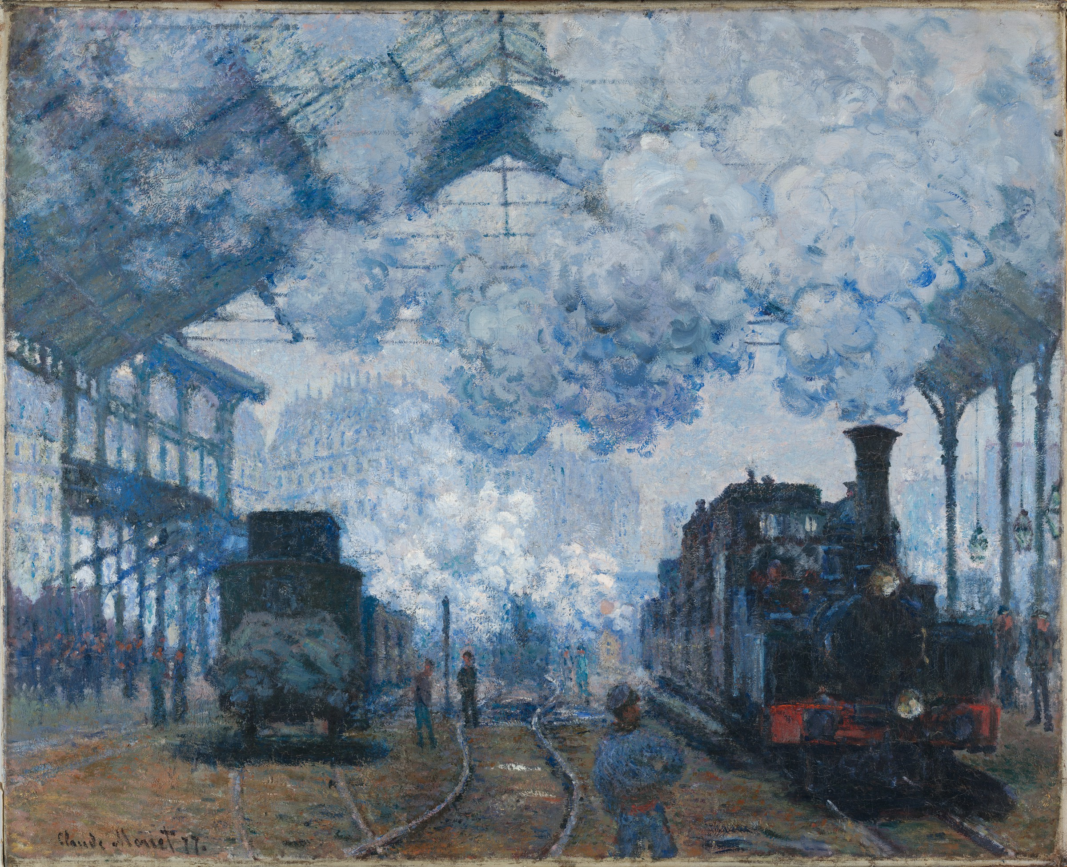
Claude Monet, Gare Saint-Lazare: Arrival of a Train (1877)
Harvard University, Fogg Art Museum

